Slide 1
Data Decode Academy: Performance Metrics 2025
A Review of Business & Marketing Insights

Slide 2
Data Overview
Source: The data was collected from internal business systems, including our sales database, marketing platform, and consultant performance tracking tools.
Time Period: The dataset covers a full calendar year, from January 1, 2025, to December 31, 2025. This allows for a complete year-end analysis
Key Columns: The dataset includes several key fields which were used to create the dashboard, such as:
Date: The date of the transaction or event.
Consultant Name: The name of the consultant associated with the sale.
Training Level & Model: The specific course name and type (e.g., Ftdis. L5, SE).
Sales Revenue & Fees: The financial amount generated from each transaction.
Channel: The marketing source (e.g., TV Ad, Facebook Page) that drove the lead or sale.
Call Type: Whether the call was paid or unpaid.
Area Code: The geographic location of the client.
Data Size: The dataset contains 1216 rows, representing every transaction for the year.

Slide 3
AIM
To increase the academy's market share and profitability by optimizing marketing spend and consultant performance.

Slide 4
MISSION AND VISION
Mission
To provide high-quality, in-demand training models that empower individuals with the skills needed to succeed in their careers. We will achieve this by leveraging data-driven insights to refine our curriculum, enhance our marketing efforts, and empower our consultants to deliver exceptional value.
Vision
To be the leading professional training academy in the market, recognized for our innovative learning models, industry-best success rates, and commitment to student empowerment. We aim to expand our reach by strategically investing in high-performing channels and developing a culture of continuous improvement based on data.

Slide 5
Data Cleaning and Preparation
Find & Replace: I used the “Find & Replace” function to correct inconsistent spellings and standardize text, such as ensuring all consultant names and channel names were uniform.
Data Type Formatting: I formatted columns like "Sales Revenue" and "Fees" to a “Number” or “Currency” format to make sure they could be used in calculations. I also formatted the date column to a standard “Date” format.
Filtering and Sorting: I used “Filter” to identify and inspect rows with missing data or potential errors. I also used “Sort” to quickly organize the data by month, consultant, or channel to look for trends and outliers.
PivotTables and Formulas: I used “SUMIFS”, “COUNTIFS”, and other formulas to calculate the total figures for sales, calls, and enrollments. I then used “PivotTables” to easily summarize the data by "Consultant," "Channel," and "Month" to create the charts and graphs you see on the dashboard.
Removing Duplicates: I used the “Remove Duplicates” feature to ensure that each record was unique and there were no repeated rows in the dataset.

Slide 6
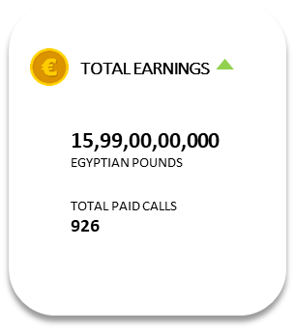
What was our total sales figure for the year?
Our total sales for the year 2022 were ₹15.99 crore.
How many of our total calls were converted to a paid service?
We converted 926 of our calls to a paid service, which is roughly 75% of all calls.

Slide 7
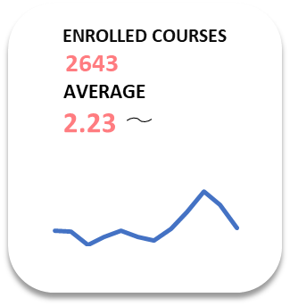
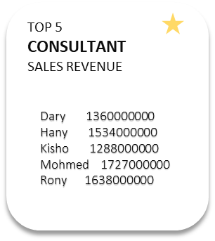
How many new courses did we enroll in?
We had a total of 2,643 new course enrollments
Which of our consultants brought in the most sales revenue?
Dary was our top-performing consultant, generating the most sales revenue.

Slide 8
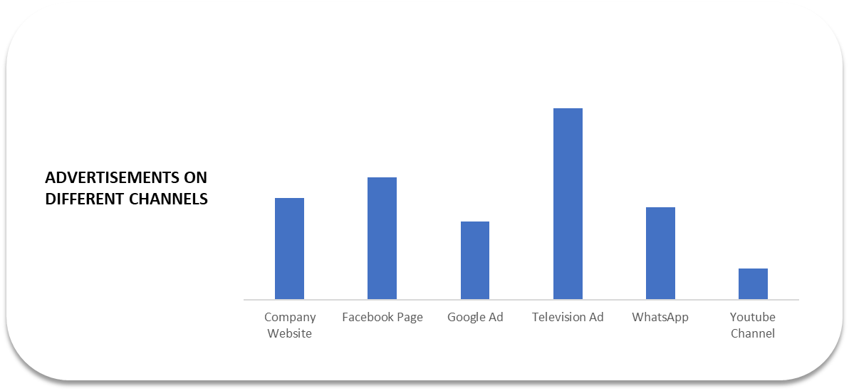
Which marketing channel was most effective at driving enrollments?
Our Television Ads were the most effective channel, leading in total course enrollments.
Which channels are underperforming?
The YouTube Channel and Google Ad are currently our lowest-performing marketing channels.

Slide 9
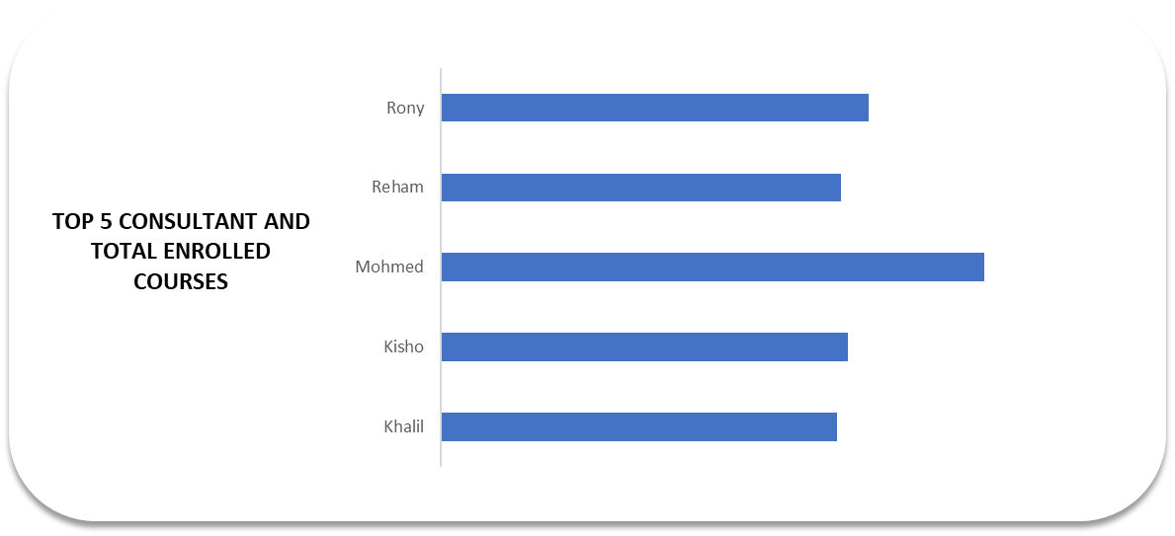
Top 5 Consultants

Slide 10
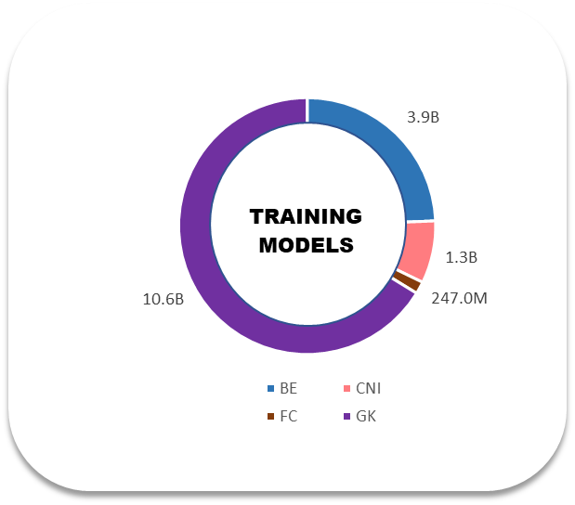
Which training model is the most popular with our students?
The GK model is our most popular training model, with the highest number of enrollments.

Slide 11
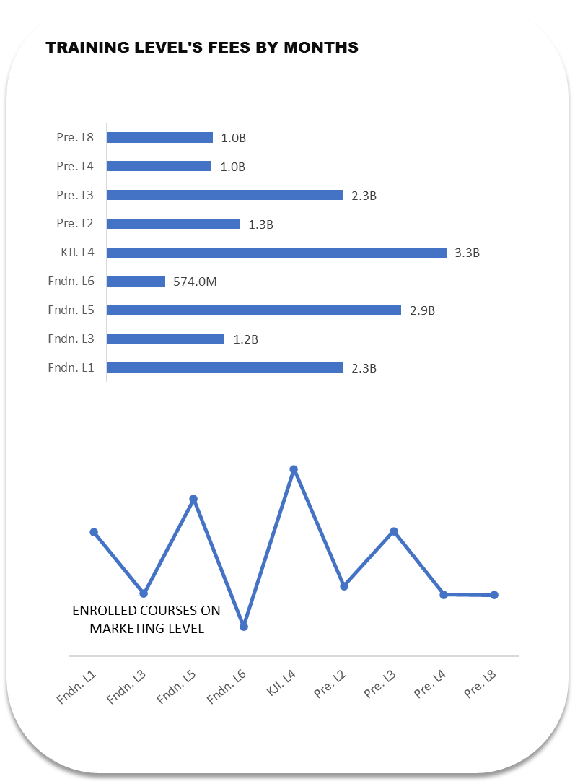
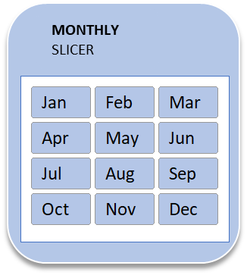
Which training level generates the most revenue?
At which level did we have the highest number of enrolled courses?
Where on the graph did course enrollment drop the most?
Does the line show that our enrollment is going up or down over time?

Slide 12
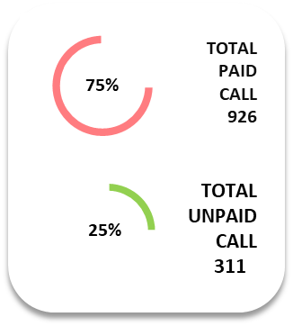
Total paid and unpaid calls
Total Paid Calls: 926
Total Unpaid Calls: 311

Slide 13
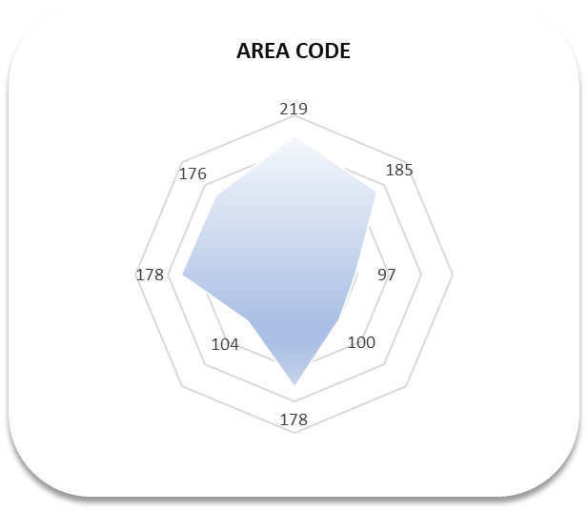
Which specific area is our strongest market?
The area with the 219 code is our strongest market, generating the most business.

Slide 14
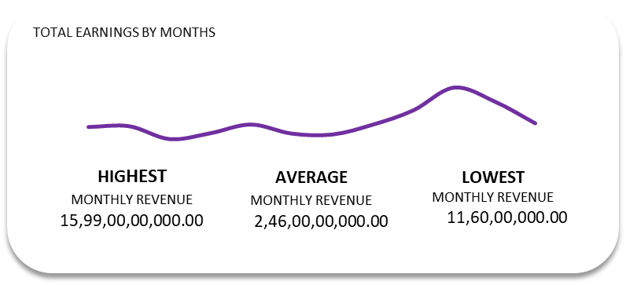
Total earnings by month
Highest Earning Month: The peak of the graph appears to be in September.
Lowest Earning Month: The lowest points on the graph are likely at the beginning of the year, possibly January or February.
Average Earnings: The dashboard shows the average monthly earnings were ₹2,46,00,00,000.

Slide 15
Strategic Recommendations
Expand on Success: “Allocate an additional 30% of our marketing budget to Television Ads, given their strong performance. Explore partnerships with other local television networks.”
Leverage Top Talent: “Initiate a mentorship program where our top-performing consultant, Dary, can share best practices with underperforming consultants.”
The Biggest Win: TV ads are our top-performing channel.
The Best Performer: Dary is our top consultant in sales.
The Main Opportunity: The FC and GK models are areas for growth.

Slide 16
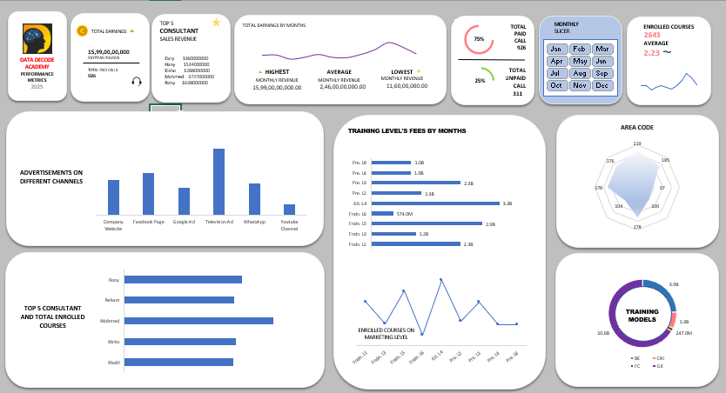
DASHBOARD

Slide 17
THANKYOU

